Slide 1
Temperature

Slide 2
Thermodynamics
Thermodynamics involves situations in which the temperature or state of a system changes due to energy transfers.
Thermodynamics is very successful in explaining the bulk properties of matter.
Also successful in explaining the correlation between these properties and the mechanics of atoms and molecules.
.
Thermodynamics also addresses practical questions:
  How a refrigerator is able to cool its contents
  What types of transformations occur in a power plant
  What happens to the kinetic energy of an object as it comes to a rest

Slide 3
Temperature
We associate the concept of temperature with how hot or cold an object feels.
Our senses provide us with a qualitative indication of temperature.
Our senses are unreliable for this purpose.
We need a reliable and reproducible method for measuring the relative hotness or coldness of objects.
  We need a technical definition of temperature.

Slide 4
Overview
To describe thermal phenomena, careful definitions are needed:
  Temperature
  Heat
  Internal energy
Thermal phenomena involving particular substances is important.
Ideal gases on a macroscopic scale can be described .
  Concerned with relationships among such things as pressure, volume, and temperature

Slide 5
Thermal Contact and Thermal Equilibrium
Two objects are in thermal contact with each other if energy can be exchanged between them.
  The exchanges we will focus on will be in the form of heat or electromagnetic radiation.
The energy is exchanged due to a temperature difference.
Thermal equilibrium is a situation in which two objects would not exchange energy by heat or electromagnetic radiation if they were placed in thermal contact.
  The thermal contact does not have to also be physical contact.

Slide 6
Zeroth Law of Thermodynamics
If objects A and B are separately in thermal equilibrium with a third object C, then A and B are in thermal equilibrium with each other.
  Let object C be the thermometer
  Since they are in thermal equilibrium with each other, there is no energy exchanged among them.

Slide 7
Temperature – Definition
Temperature can be thought of as the property that determines whether an object is in thermal equilibrium with other objects.
Two objects in thermal equilibrium with each other are at the same temperature.
  If two objects have different temperatures, they are not in thermal equilibrium with each other.
Temperature is something that determines whether or not energy will transfer between two objects in thermal contact.

Slide 8
Thermometers
A thermometer is a device that is used to measure the temperature of a system.
Thermometers are based on the principle that some physical property (known as the thermometric property) of a system changes as the system’s temperature changes.
These properties include:
  The volume of a liquid
  The dimensions of a solid
  The pressure of a gas at a constant volume
  The volume of a gas at a constant pressure
  The electric resistance of a conductor
  The color of an object
A temperature scale can be established on the basis of any of these physical properties.

Slide 9
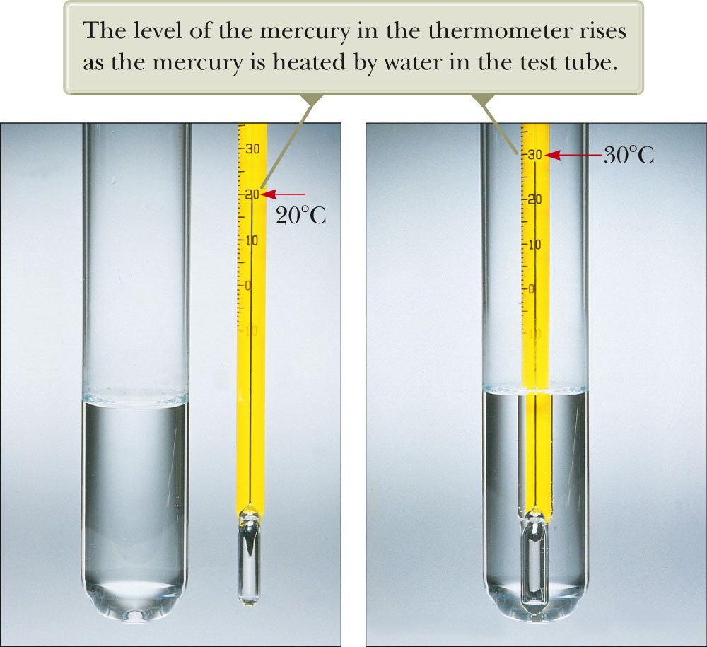
Thermometer, Liquid in Glass
A common type of thermometer is a liquid-in-glass.
The material in the capillary tube expands as it is heated.
The liquid is usually mercury or alcohol.

Slide 10
Calibrating a Thermometer
A thermometer can be calibrated by placing it in contact with some natural systems that remain at constant temperature.
Common systems involve water
  A mixture of ice and water at atmospheric pressure
    Called the ice point of water
  A mixture of water and steam in equilibrium
    Called the steam point of water
Once these points are established, the length between them can be divided into a number of segments.

Slide 11
Problems with Liquid-in-Glass Thermometers
An alcohol thermometer and a mercury thermometer may agree only at the calibration points.
The discrepancies between thermometers are especially large when the temperatures being measured are far from the calibration points.
The thermometers also have a limited range of values that can be measured.
  Mercury cannot be used under –39º C
  Alcohol cannot be used above 78.4º C

Slide 12
Celsius Scale
The ice point of water is defined to be 0º C.
The steam point of water is defined to be 100º C.
The length of the column between these two points is divided into 100 increments, called degrees.

Slide 13
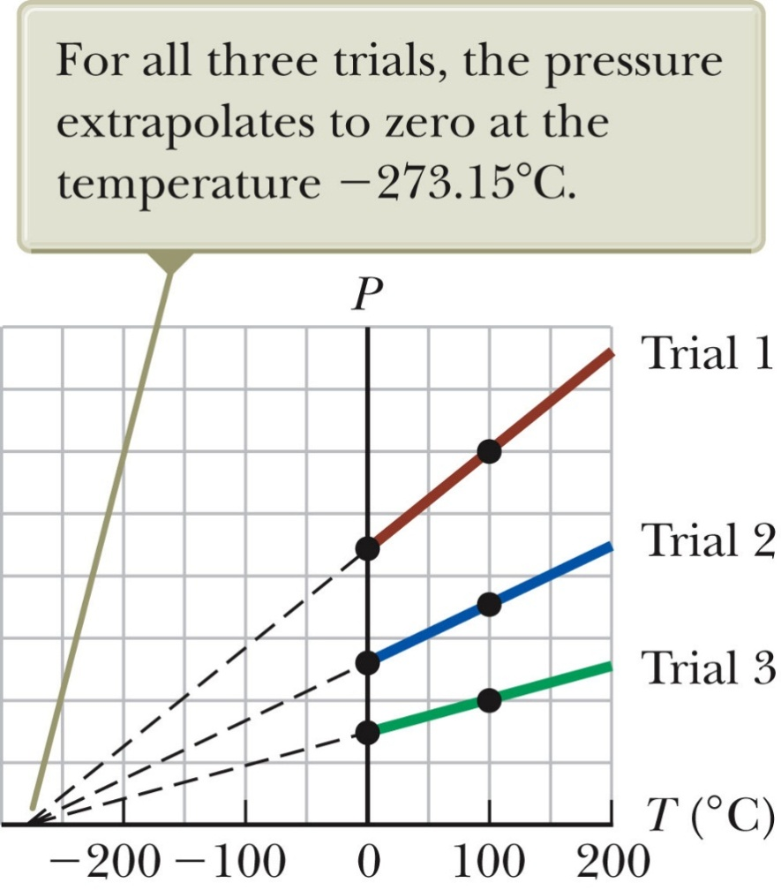
Absolute Zero
For constant volume gas thermometer, the thermometer readings are virtually independent of the gas used.
If the lines for various gases are extended, the pressure is always zero when the temperature is –273.15º C.
This temperature is called absolute zero.
Absolute zero is used as the basis of the absolute temperature scale.
The size of the degree on the absolute scale is the same as the size of the degree on the Celsius scale.
To convert: T_{C} = T – 273.15

Slide 14
Absolute Temperature Scale
The absolute temperature scale is now based on two new fixed points.
  One point is absolute zero.
  The other point is the triple point of water.
    This is the combination of temperature and pressure where ice, water, and steam can all coexist.
The triple point of water occurs at 0.01º C and 4.58 mm of mercury.
This temperature was set to be 273.16 on the absolute temperature scale.
  This made the old absolute scale agree closely with the new one.
  The units of the absolute scale are kelvins.
  The absolute scale is also called the Kelvin scale.

Slide 15
Fahrenheit Scale
A common scale in everyday use in the US
  Named for Daniel Fahrenheit
Temperature of the ice point is 32ºF.
Temperature of the steam point is 212ºF
There are 180 divisions (degrees) between the two reference points.

Slide 16
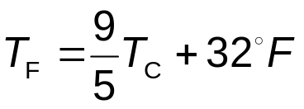
Comparison of Scales
Celsius and Kelvin have the same size degrees, but different starting points.
  T_{C} = T – 273.15
Celsius and Fahrenheit have different sized degrees and different starting points.
Ice point temperatures
  0ºC = 273.15 K = 32º F
Steam point temperatures
  100ºC = 373.15 K = 212º F

Slide 17
Thermal Expansion
Thermal expansion is the increase in the size of an object with an increase in its temperature.
Thermal expansion is a consequence of the change in the average separation between the atoms in an object.
If the expansion is small relative to the original dimensions of the object, the change in any dimension is, to a good approximation, proportional to the first power of the change in temperature.

Slide 18
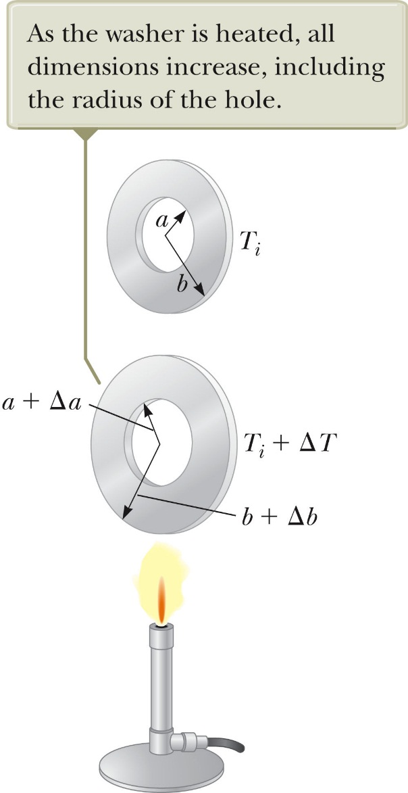
Thermal Expansion, example
As the washer shown at right is heated, all the dimensions will increase.
A cavity in a piece of material expands in the same way as if the cavity were filled with the material.
The expansion is exaggerated in this figure.

Slide 19
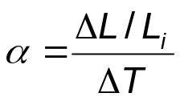
Linear Expansion
Assume an object has an initial length L_{i}.
That length increases by ΔL as the temperature changes by ΔT.
We define the coefficient of linear expansion as
A convenient form is ΔL = αL_{i} ΔT
This equation can also be written in terms of the initial and final conditions of the object:
  L_{f} – L_{i} = α L_{i} (T_{f} – T_{i})
The coefficient of linear expansion, α, has units of (ºC)⁻¹

Slide 20
Linear Expansion, cont.
Some materials expand along one dimension, but contract along another as the temperature increases.
Since the linear dimensions change, it follows that the surface area and volume also change with a change in temperature.
A hole in a piece of material expands in the same way as if the cavity were filled with the material.
The notion of thermal expansion can be thought of as being similar to a photographic enlargement.

Slide 21
Volume Expansion
The change in volume is proportional to the original volume and to the change in temperature.
ΔV = βV_{i} ΔT
  β is the coefficient of volume expansion.
  For a solid, β = 3α
    This assumes the material is isotropic, the same in all directions.
  For a liquid or gas, β is given in the table

Slide 22
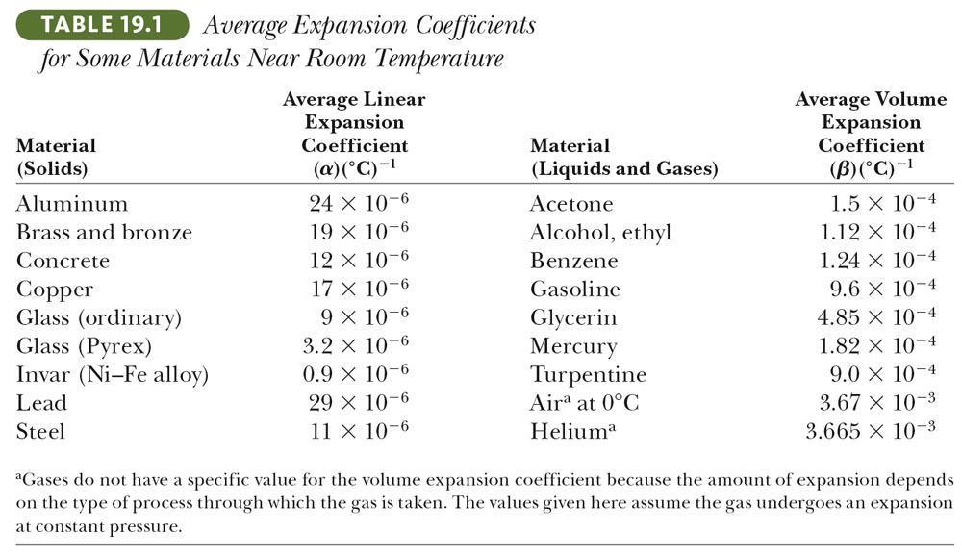
Some Coefficients

Slide 23
Area Expansion
The change in area is proportional to the original area and to the change in temperature:
  ΔA = 2αA_{i} ΔT

Slide 24
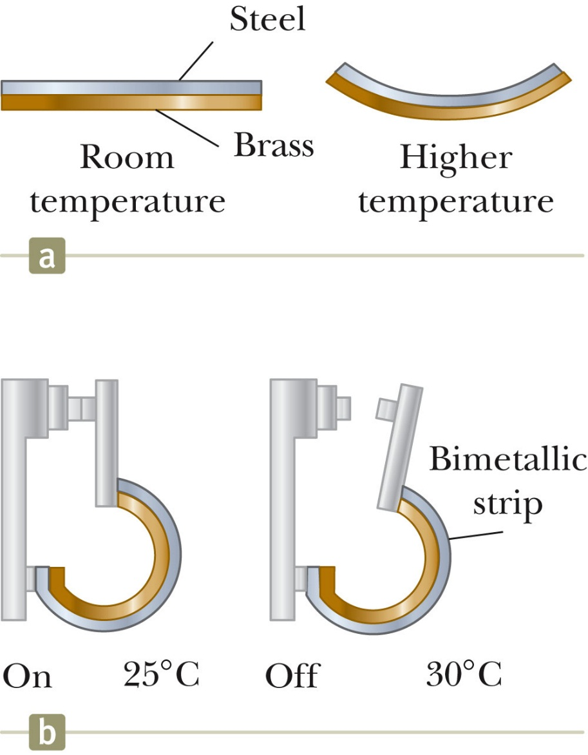
Bimetallic Strip
Each substance has its own characteristic average coefficient of expansion.
This can be made use of in the device shown, called a bimetallic strip.
  As the temperature of the strip increases, the two metals expand by different amounts.
  The strip bends.
It can be used in a thermostat.

Slide 25
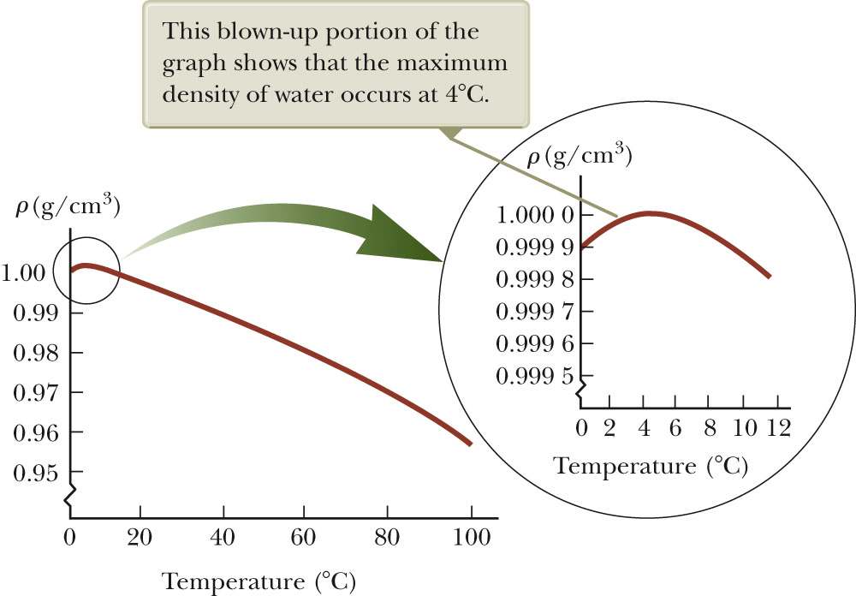
Water’s Unusual Behavior
As the temperature increases from 0ºC to 4ºC, water contracts.
  Its density increases.
Above 4ºC, water expands with increasing temperature.
  Its density decreases.
The maximum density of water (1.000 g/cm³) occurs at 4ºC.

Slide 26
An Ideal Gas
For gases, the interatomic forces within the gas are very weak.
  We can imagine these forces to be nonexistent.
Note that there is no equilibrium separation for the atoms.
  Thus, no “standard” volume at a given temperature.
For a gas, the volume depends on the size of the container.
Equations involving gases will contain the volume, V, as a variable.
  This is instead of focusing on ΔV.

Slide 27
Gas: Equation of State
It is useful to know how the volume, pressure, and temperature of the gas of mass m are related.
The equation that interrelates these quantities is called the equation of state.
  These are generally quite complicated.
  If the gas is maintained at a low pressure, the equation of state becomes much easier.
  The equation of state can be determined from experimental results.
  This type of a low density gas is commonly referred to as an ideal gas.

Slide 28
Ideal Gas Model
The ideal gas model can be used to make predictions about the behavior of gases.
  If the gases are at low pressures, this model adequately describes the behavior of real gases.

Slide 29
The Mole
The amount of gas in a given volume is conveniently expressed in terms of the number of moles, n.
One mole of any substance is that amount of the substance that contains Avogadro’s number of constituent particles.
  Avogadro’s number is N_{A} = 6.022 x 10²³
  The constituent particles can be atoms or molecules.

Slide 30
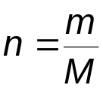
Moles, cont
The number of moles can be determined from the mass of the substance:
  M is the molar mass of the substance.
    Can be obtained from the periodic table
    Is the atomic mass expressed in grams/mole
      Example: He has mass of 4.00 u so M = 4.00 g/mol
  m is the mass of the sample.
  n is the number of moles.

Slide 31
Gas Laws
When a gas is kept at a constant temperature, its pressure is inversely proportional to its volume (Boyle’s law).
When a gas is kept at a constant pressure, its volume is directly proportional to its temperature (Charles and Gay-Lussac’s law).
When the volume of the gas is kept constant, the pressure is directly proportional to the temperature (Guy-Lussac’s law).

Slide 32
Ideal Gas Law
The equation of state for an ideal gas combines and summarizes the other gas laws:
      PV = nRT
This is known as the ideal gas law.
R is a constant, called the Universal Gas Constant.
  R = 8.314 J/mol ∙ K = 0.08214 L ∙ atm/mol ∙ K
From this, you can determine that 1 mole of any gas at atmospheric pressure and at 0º C is 22.4 L.

Slide 33
Ideal Gas Law, cont
The ideal gas law is often expressed in terms of the total number of molecules, N, present in the sample.
PV = nRT = (N/N_{A}) RT = Nk_{B}T
  k_{B} is Boltzmann’s constant
  k_{B} = 1.38 x 10⁻²³ J/K
It is common to call P, V, and T the thermodynamic variables of an ideal gas.
If the equation of state is known, one of the variables can always be expressed as some function of the other two.

Slide 34
Problem
A child has a temperature of 104°F. What is the temperature in degrees
kelvin?
Ans: 313

Slide 35
Problem
A bridge is made with segments of concrete 50 m long. If the linear expansion coefficient is 12 ´ 10⁻⁶ (°C)⁻¹, how much spacing (in cm) is needed to allow for expansion during an extreme temperature change of 150° F?
Ans: 5 cm

Slide 36
Problem
A building made with a steel structure is 650 m high on a winter day when the temperature is 0° F. How much taller (in cm) is the building when it is 100° F? (The linear expansion coefficient of steel is 11 x 10⁻⁶ (°C)⁻¹.)

